Slide 1
Chapter 14
How to work with browser objects, cookies, and web storage

Slide 2
Objectives (part 1)
Applied
Use the properties and methods of the location and history objects in your applications.
Use cookies in your applications.
Use web storage in your applications.
Use Chrome’s developer tools to work with cookies and web storage.
Knowledge
Describe these properties and methods of the location object: href, reload(), and replace().
Describe these properties and methods of the history object: length, back(), forward(), and go().
Describe the use of cookies.

Slide 3
Objectives (part 2)
Distinguish between session and persistent cookies.
Describe the use of web storage.
Distinguish between session storage and local storage.

Slide 4
A URL with search parameters
http://www.murach.com:8181/javascript/ location.html?first=G&last=Hopper#result

Slide 5
Properties of the location object
Property Value in the URL above
href Complete URL
protocol http:
hostname www.murach.com
port 8181
host www.murach.com:8181
path /javascript/location.html
search ?first=G&last=Hopper
hash #result
Methods of the location object
Method Description
reload(force) Reloads the current webpage.
replace(url) Loads a new page in the browser and replaces the current page in the history list.

Slide 6
How to load a new web page
location.href = "https://www.murach.com";
location = "https://www.murach.com";
How to reload a web page
location.reload(); // reloads the current page from the cache
location.reload(true);
// reloads the current page from the server
How to load a new page and overwrite the current history page
location.replace("https://www.murach.com");

Slide 7
One property of the history object
Property Description
length The number of URLs in the history object
Methods of the history object
Method Description
back() Goes back one step in the URL history
forward() Goes forward one step in the URL history
go(position) Goes forward or back the specified number of steps in the URL history
go(substring) Goes to the most recent URL in the history that contains the substring

Slide 8
How to use the back() method
history.back();
How to use the forward() method
history.forward();
How to use the go() method
Go forward two URLs
history.go(2);
Go back three URLs
history.go(-3);
Go to the most recent URL that contains "google"
history.go("google");

Slide 9
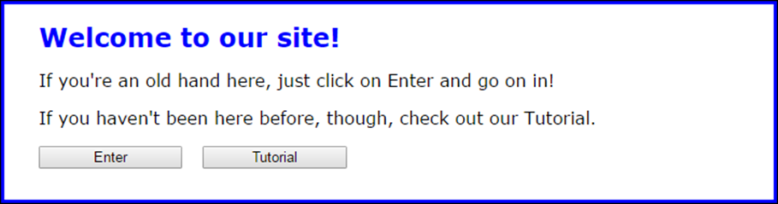
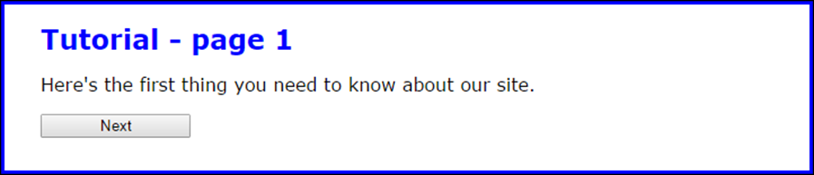
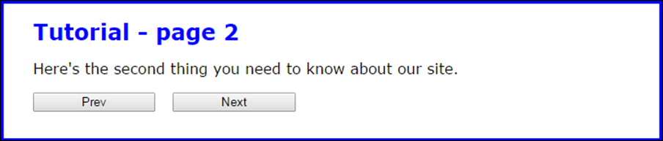
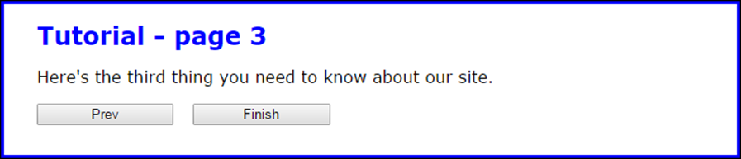
The four pages of the Tutorial application

Slide 10
The HTML in the main element of the index.html file
<h1>Welcome to our site!</h1>
<p>If you're an old hand here, just click on Enter and go
on in!</p>
<p>If you haven't been here before, though, check out our
Tutorial.</p>
<input type="button" id="enter" value="Enter">
<input type="button" id="tutorial" value="Tutorial">

Slide 11
The HTML in the main element of the tutorial files
tutorial1.html
<h1>Tutorial - page 1</h1>
<p>Here's the first thing you need to know about our
site.</p>
<input type="button" id="next" value="Next">
tutorial2.html
<h1>Tutorial - page 2</h1>
<p>Here's the second thing you need to know about our
site.</p>
<input type="button" id="prev" value="Prev">
<input type="button" id="next" value="Next">
tutorial3.html
<h1>Tutorial - page 3</h1>
<p>Here's the third thing you need to know about our
site.</p>
<input type="button" id="prev" value="Prev">
<input type="button" id="next" value="Finish">

Slide 12
The JavaScript for each HTML file (part 1)
index.html
<script>
$("#enter").click( () => location = "main.html");
$("#tutorial").click( () =>
location = "tutorial1.html");
</script>
tutorial1.html
<script>
$("#next").click( () =>
location.replace("tutorial2.html"));
</script>

Slide 13
The JavaScript for each HTML file (part 2)
tutorial2.html
<script>
$("#prev").click( () =>
location.replace("tutorial1.html"));
$("#next").click( () =>
location.replace("tutorial3.html"));
</script>
tutorial3.html
<script>
$("#prev").click( () =>
location.replace("tutorial2.html"));
$("#next").click( () =>
location.replace("main.html"));
</script>

Slide 14
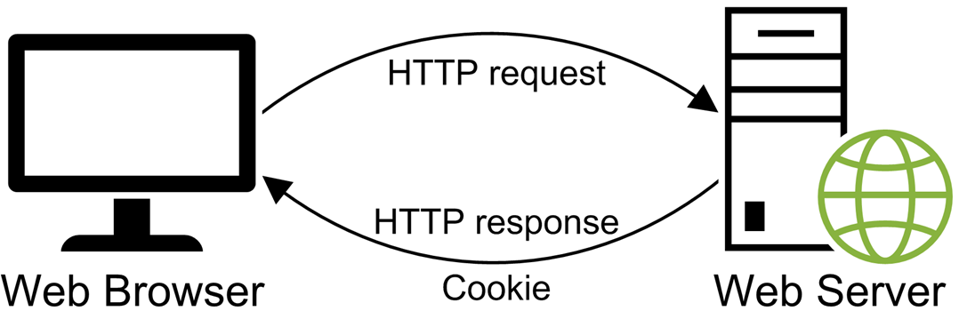
A browser usually gets a cookie as part of an HTTP response

Slide 15
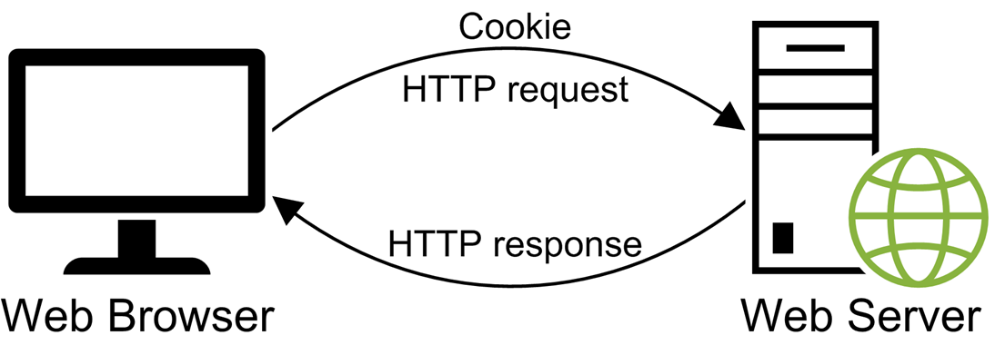
A browser sends the cookie back to the server with each HTTP request

Slide 16
Attributes of a cookie
Attribute Description
max-age The lifetime of the cookie in seconds
path The path on the web server that can see the cookie
domain The domain names that can see the cookie
secure If present, the cookie must be encrypted when it is transmitted, and it can only be transmitted when the browser and server are connected by HTTPS or another secure protocol.
Cookie examples
email=grace@yahoo.com; path=/
username=ghopper; max-age=1814400; path=/

Slide 17
Terms related to cookies
cookie
session cookie
persistent cookie

Slide 18
Two functions for working with cookies
encodeURIComponent(value)
decodeURIComponent(value)

Slide 19
How to create a session cookie
// create the cookie name
let cookie = "tasks=";
// encode and add the data
cookie +=
encodeURIComponent("Feed dog\nWater plants");
// add the path
cookie += "; path=/";
// store the cookie
document.cookie = cookie;

Slide 20
How to create a persistent cookie
// create the cookie name
let cookie = "tasks=";
// encode and add the data
cookie +=
encodeURIComponent("Feed dog\nWater plants");
// add the max-age attribute
cookie += "; max-age=" + 21 * 24 * 60 * 60;
// add the path
cookie += "; path=/";
// store the cookie
document.cookie = cookie;

Slide 21
How to add multiple cookies to the document.cookie object
document.cookie = "email=john@doe.com; path=/"
document.cookie =
"username=ghopper; max-age=1814400; path=/"
document.cookie = "email=grace@yahoo.com; path=/"
The cookies that are added to the document.cookie object
email=grace@yahoo.com; username=ghopper

Slide 22
A setCookie() function that creates a session or persistent cookie
const setCookie = (name, value, days) => {
// concatenate cookie name and encoded value
let cookie = name + "=" + encodeURIComponent(value);
// if there's a value for days, add max-age to cookie
if (days) {
cookie += "; max-age=" + days * 24 * 60 * 60;
}
// add the path and then store the cookie
cookie += "; path=/";
document.cookie = cookie;
};
How to use the setCookie() function to create a persistent cookie
setCookie("tasks", "Water plants", 21);

Slide 23
Three cookies in the document.cookie object
username=ghopper; status=active; tasks=Water%20plants
A getCookieByName() function that gets a cookie by name (part 1)
const getCookieByName = name => {
const cookies = document.cookie;
// get the starting index of the cookie name
// followed by an equals sign
let start = cookies.indexOf(name + "=");
if (start === -1) { // no cookie with that name
return ""; // return empty string
}
else { // get cookie value
// adjust so the name and equals sign
// aren't included in the result
start = start + (name.length + 1);

Slide 24
A getCookieByName() function that gets a cookie by name (part 2)
// get the index of the semi-colon at the end
// of the cookie value
let end = cookies.indexOf(";", start);
if (end === -1) { // last cookie
end = cookies.length;
}
// use the start and end indexes to get
// the cookie value
const cookieValue =
cookies.substring(start, end);
// return the decoded cookie value
return decodeURIComponent(cookieValue);
}
};
How to use the getCookieByName() function to read a cookie
const tasks = getCookieByName("tasks"); // tasks = "Water plants"

Slide 25
The cookie to delete
tasks=Feed dog; max-age=1814400; path=/
How to delete a cookie
let cookie = "tasks="; // set the name and data
cookie += "; max-age=" + 0; // set max-age to 0
cookie += "; path=/"; // set the path
document.cookie = cookie; // delete the cookie

Slide 26
A deleteCookie() function that deletes a cookie
const deleteCookie = name => {
document.cookie = name + "=''; max-age=0; path=/";
};
How to delete a cookie
deleteCookie("tasks");

Slide 27
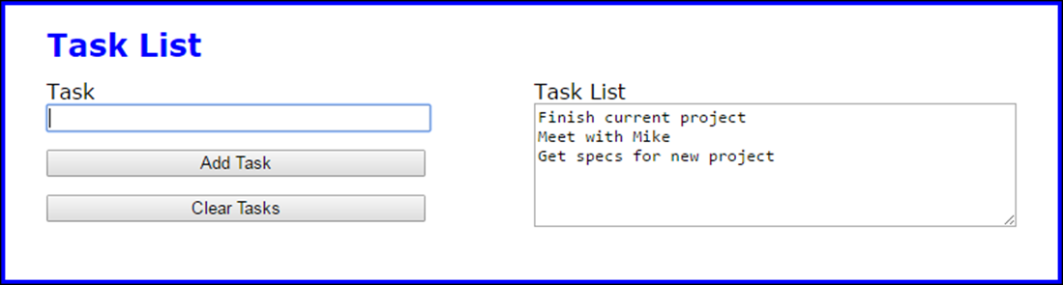
The Task List application

Slide 28
The HTML for the Task List application (part 1)
<!DOCTYPE html>
<html>
<head>
<meta charset="UTF-8">
<meta name="viewport"
content="width=device-width, initial-scale=1">
<title>Task List</title>
<link rel="stylesheet" href="task_list.css">
</head>
<body>
<main>
<h1>Task List</h1>
<div id="tasks">
<label for="task_list">Task List</label><br>
<textarea id="task_list" rows="6" cols="50">
</textarea>
</div>
<div>
<label for="task">Task</label><br>
<input type="text" name="task" id="task">
</div>

Slide 29
The HTML for the Task List application (part 2)
<div>
<input type="button" name="add_task"
id="add_task" value="Add Task"><br>
<input type="button" name="clear_tasks"
id="clear_tasks" value="Clear Tasks">
</div>
</main>
<script
src="https://code.jquery.com/jquery-3.4.1.min.js">
</script>
<script src="task_list.js"></script>
</body>
</html>

Slide 30
The CSS for the div element with “tasks” as its id
#tasks {
margin-top: 0;
float: right;
}

Slide 31
The JavaScript for the Task List app (part 1)
const setCookie = (name, value, days) => {
let cookie = name + "=" + encodeURIComponent(value);
if (days) {
cookie += "; max-age=" + days * 24 * 60 * 60;
}
cookie += "; path=/";
document.cookie = cookie;
};
const getCookieByName = name => {
const cookies = document.cookie;
let start = cookies.indexOf(name + "=");
if (start === -1) {
return "";
} else {
start = start + (name.length + 1);
let end = cookies.indexOf(";", start);
if (end === -1) {
end = cookies.length;
}
const cookieValue = cookies.substring(start, end);
return decodeURIComponent(cookieValue);
}
};

Slide 32
The JavaScript for the Task List app (part 2)
const deleteCookie = name =>
document.cookie = name + "=''; max-age=0; path=/";
$(document).ready( () => {
$("#add_task").click( () => {
const textbox = $("#task");
const task = textbox.val();
if (task === "") {
alert("Please enter a task.");
textbox.focus();
} else {
let tasks = getCookieByName("tasks");
tasks = tasks.concat(task, "\n");
setCookie("tasks", tasks, 21);
textbox.val("");
$("#task_list").val(getCookieByName("tasks"));
textbox.focus();
}
});

Slide 33
The JavaScript for the Task List app (part 3)
$("#clear_tasks").click( () => {
deleteCookie("tasks");
$("#task_list").val("");
$("#task").focus();
});
// display tasks on initial load
$("#task_list").val(getCookieByName("tasks"));
$("#task").focus();
});

Slide 34
The syntax for working with local storage
// saves the data in the item
localStorage.setItem("key", "value")
// gets the data in the item
localStorage.getItem("key")
// removes the item
localStorage.removeItem("key")
// removes all items
localStorage.clear()

Slide 35
The syntax for working with session storage
// saves the data in the item
sessionStorage.setItem("key", "value")
// gets the data in the item
sessionStorage.getItem("key")
// removes the item
sessionStorage.removeItem("key")
// removes all items
sessionStorage.clear()

Slide 36
The shortcut syntax for getting or saving an item
// save or get the data in the local storage item
localStorage.key
// save or get the data in the session storage item
sessionStorage.key

Slide 37
JavaScript that uses local and session storage for hit counters
$(document).ready( () => {
if (localStorage.hits) {
localStorage.hits =
parseInt(localStorage.hits) + 1;
} else { localStorage.hits = 1; }
if (sessionStorage.hits) {
sessionStorage.hits =
parseInt(sessionStorage.hits) + 1;
} else { sessionStorage.hits = 1; }
console.log("Hits for this browser: " +
localStorage.hits + "\n" +
"Hits for this session: " +
sessionStorage.hits)
});

Slide 38
A console message that shows the current values of both hits items
Hits for this browser: 5
Hits for this session: 2

Slide 39
Terms related to web storage
web storage
key/value pair
local storage
session storage

Slide 40
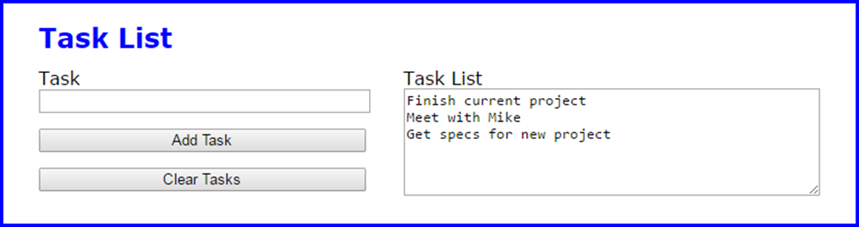
The Task List application with web storage

Slide 41
The JavaScript for the Task List application with web storage (part 1)
$(document).ready( () => {
$("#add_task").click( () => {
const textbox = $("#task");
const task = textbox.val();
if (task === "") {
alert("Please enter a task.");
textbox.focus();
} else {
let tasks = localStorage.myTasks || "";
localStorage.myTasks =
tasks.concat(task, "\n");
textbox.val("");
$("#task_list").val(localStorage.myTasks);
textbox.focus();
}
});

Slide 42
The JavaScript for the Task List application with web storage (part 2)
$("#clear_tasks").click( () => {
localStorage.removeItem("myTasks");
$("#task_list").val("");
$("#task").focus();
});
// display tasks on initial load
$("#task_list").val(localStorage.myTasks);
$("#task").focus();
});

Slide 43
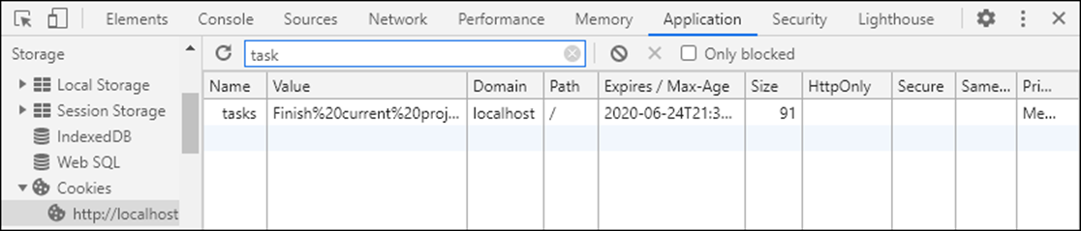
The cookies for an application in the Application panel

Slide 44
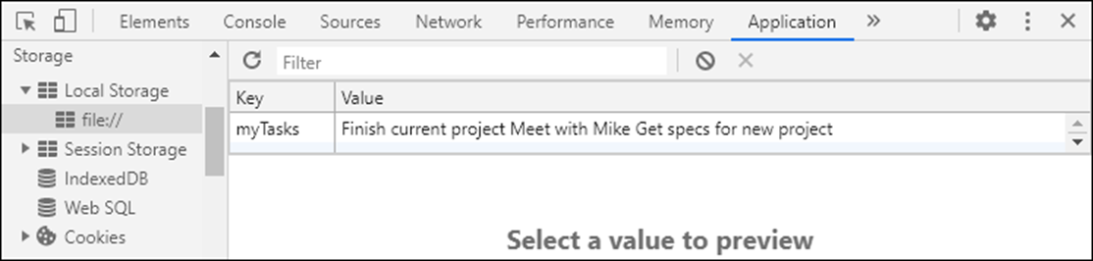
The local storage items for an application in the Application panel

Slide 45
How to view cookies and stored items
Press F12 to open the developer tools.
Click on the Application tab at the top of the tools window, and then look for the Storage section in the pane on the left-hand side.
Expand an appropriate storage type such as Cookies, Local Storage, or Session Storage.
Click on the appropriate URL to display the stored values in a grid. For cookie storage, you may want to filter the cookies by entering the name of the cookie you want to view.

Slide 46
How to delete or edit cookies or stored items
To delete an item, right-click the item and select Delete.
To edit an item, right-click the item and select Edit Value. Then, edit the text for the value.
To apply the edit or deletion to the application, make sure to refresh the page.

